Slide 1

“Second Review of Mini Project” For E3 2018 Batch Submitted as part of Mini Project G.Satish -S180116 T. Ramesh -S180523 G. Srivalli -S180427 Under the Supervision of Mrs .J.VISHNU PRIYANKA Asst.prof
d

Slide 2
Project Title
PARENT TEACHER PORTAL

Slide 3
1.Abstract:
The Parent-Teacher Portal is an innovative web-based platform designed to facilitate effective communication between parents as teachers in an educational institution. This portal incorporates a range of new features, including a calendar, student college premises Tracker, student feedbacks, course management, notifications, and transparent communication and secure registration (OPTIONAL). Moreover, the portal is developed with ensuring accessibility and usability across various devices. Overall, the Parent-Teacher Portal serves as an indispensable tool for effective communication, transparent collaboration in the educational institution. It empowers parents, teachers to actively participate in the educational journey.
Abstract

Slide 4
Introduction:
The Parent-Teacher Portal project aims to transform the way parents and teachers communicate and collaborate in the realm of education. By introducing innovative features such as a student feedback system, student college premises tracking system, and student leave request system, the project seeks to establish a direct and transparent line of communication between these key stakeholders.
The project aims to enhance parental involvement, promote collaboration, and ensure the holistic development of students. Through this initiative, the project strives to optimize communication processes, provide timely updates and feedback, and establish a user-friendly interface that empowers parents and teachers to work together towards the educational success of each student.

Slide 5
Problem-Statement:
The existing parent-teacher communication and management system lacks efficient coordination and transparency between parents, teachers, and students. The current challenges faced by the educational institution include:
1. Inefficient Communication: The lack of a centralized platform for communication and coordination between parents and teachers leads to delays and miscommunication regarding important dates, events, and academic updates.
2. Limited Student Monitoring: There is no systematic way to track and monitor student progress, attendance, assignments, and grades, making it challenging for parents and teachers to have an accurate overview of each student's performance.
3. Lack of Transparent Feedback Mechanism: The absence of a platform for parents to provide feedback on their child's progress, teacher interactions, and overall school experience hinders the improvement of educational practices and parent engagement.
4. Fragmented Notifications: Important notifications, updates, and reminders are dispersed through various channels, leading to missed communications and information overload

Slide 6
Existing System:
The existing system for parent-teacher communication relies on in-person meetings, phone calls, and paper-based communication. It involves manual processes for tracking attendance and managing leave requests. However, this system suffers from limitations such as communication barriers, lack of timely feedback, limited transparency, and difficulty in collaboration.

Slide 7
Proposed System:
The proposed Parent-Teacher Portal aims to improve communication and trasparency between parents and teachers. It includes features like student feedback submission, student college premises tracking, direct interaction , leave request management , user friendly interface to access sources and resources.This system makes communication easier, helps parents and teachers work together, and simplifies administrative processes for better student outcomes and increased parental involvement.

Slide 8
Hardware and software requirements:
The hardware and software requirements for a Parent-Teacher Portal will depend on the specific features and functionalities that are included in the system. Here are some general guidelines for the hardware and software requirements:
Hardware Requirements:
Processor: Intel Core i3 or higher
Memory (RAM): 4 GB or higher
Storage: 100 GB or higher
Display: 14-inch or higher with a minimum resolution of 1024x768
Internet connection: High-speed broadband with a minimum speed of 2 Mbps

Slide 9
Software Requirements:
Operating System: Windows 10 or Mac OS X 10.15 or higher
Web Browser: Chrome, Firefox, or Safari
Database: MySQL or SQL Server
Programming Languages: PHP, JavaScript, HTML, and CSS
Content Management System: WordPress
Microsoft office.

Slide 10
Frontend modules:
1.Student college Tracker
2.Student leave request
3.Student feedback

Slide 11
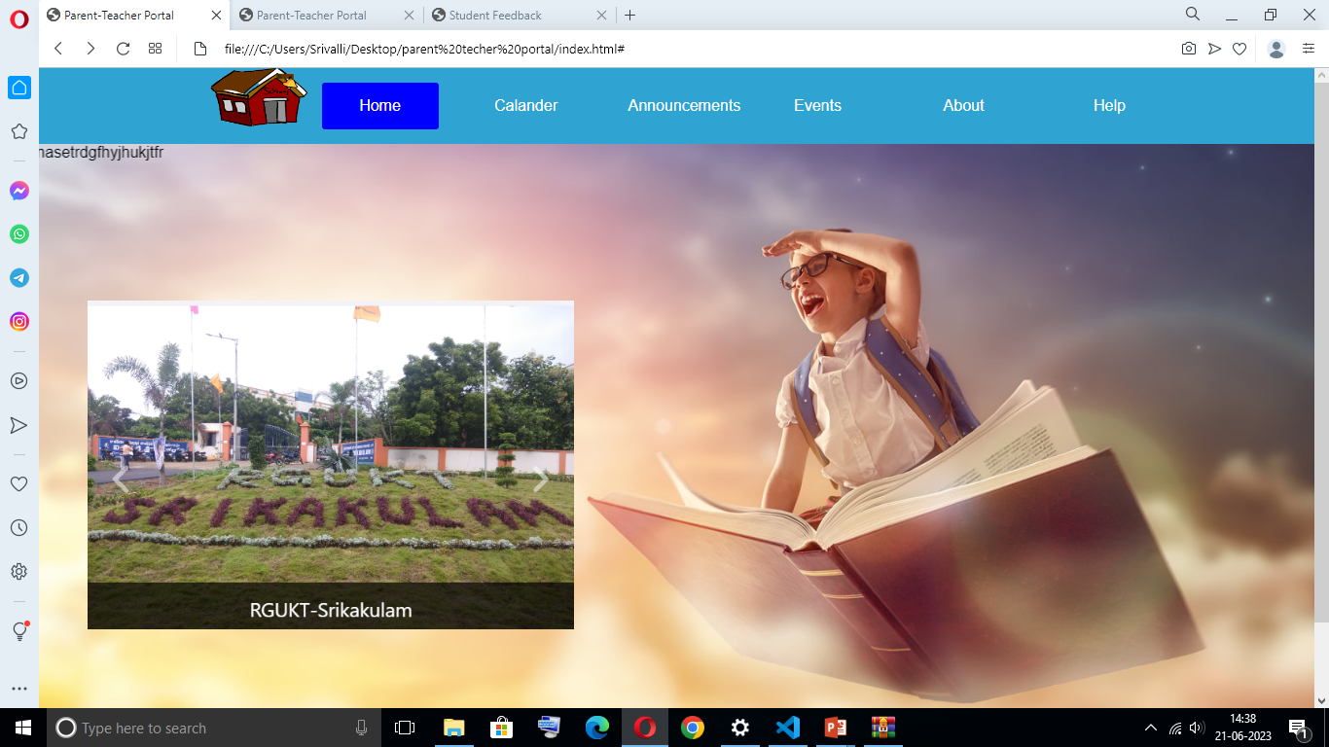
Main interface:

Slide 12
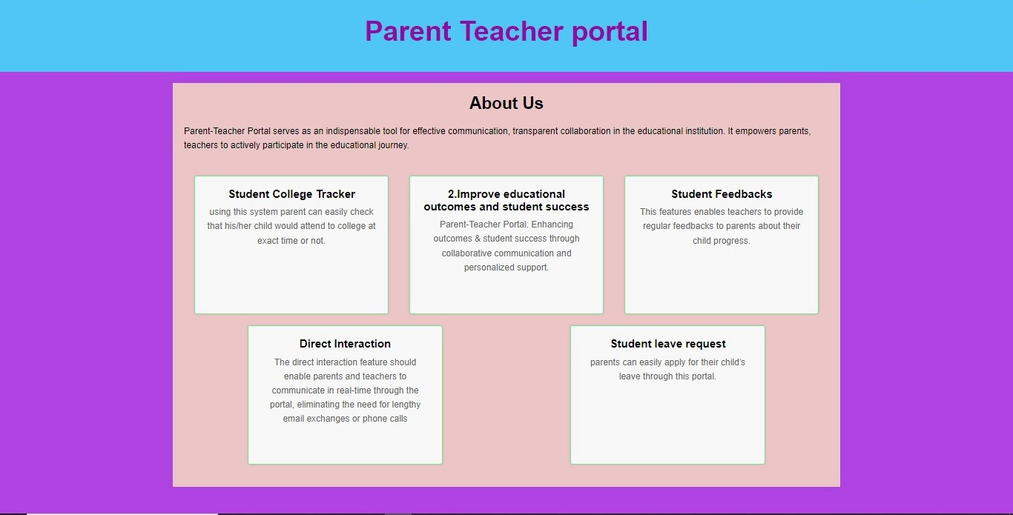
About

Slide 13
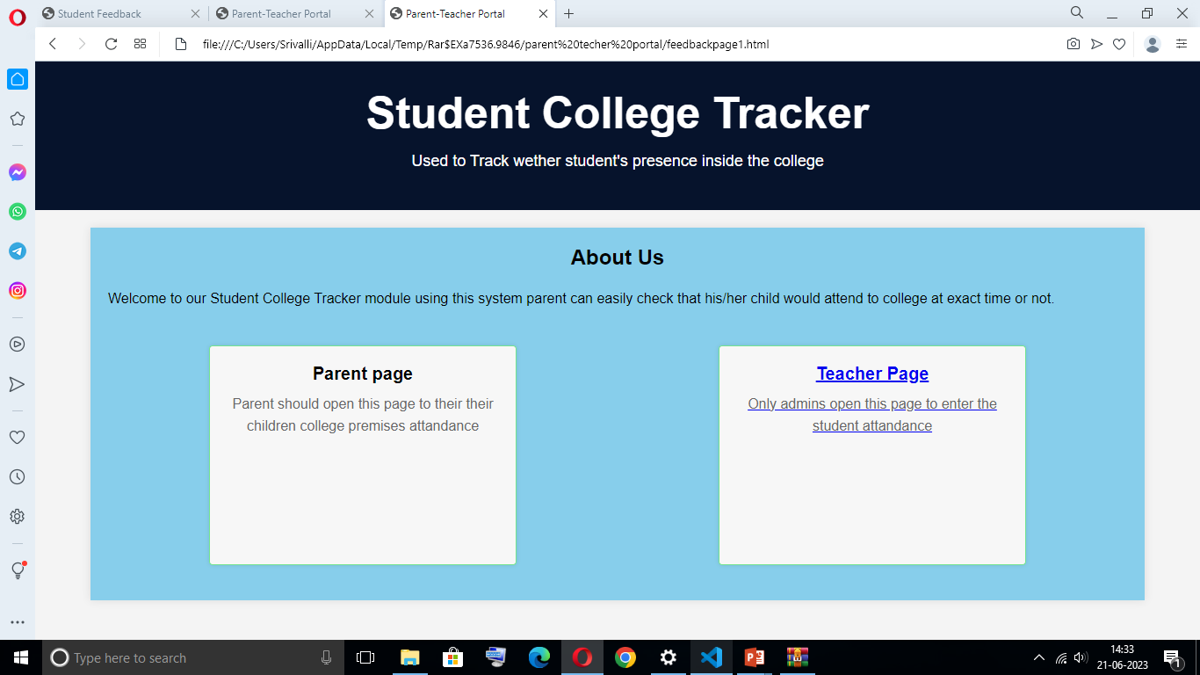
1.Student college Tracker:

Slide 14
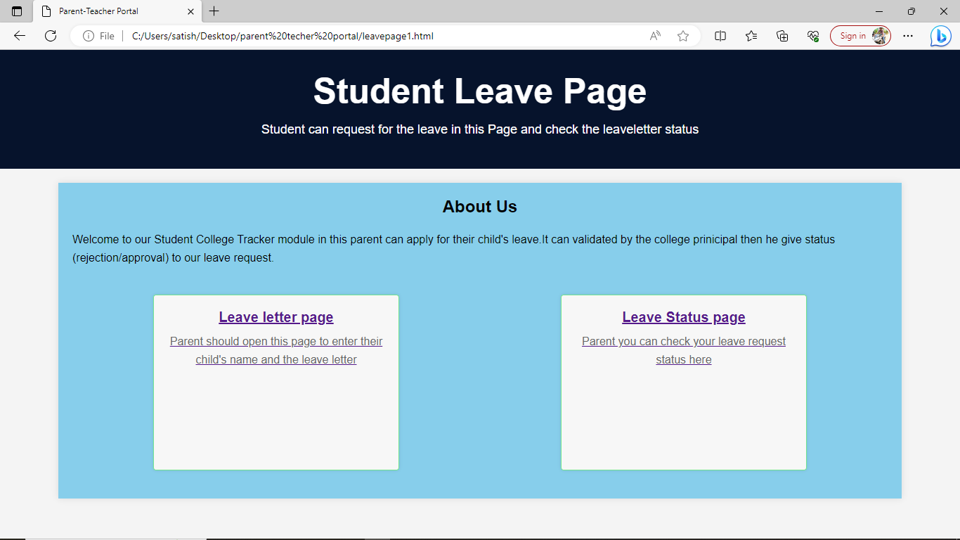
2.Student leave request:

Slide 15
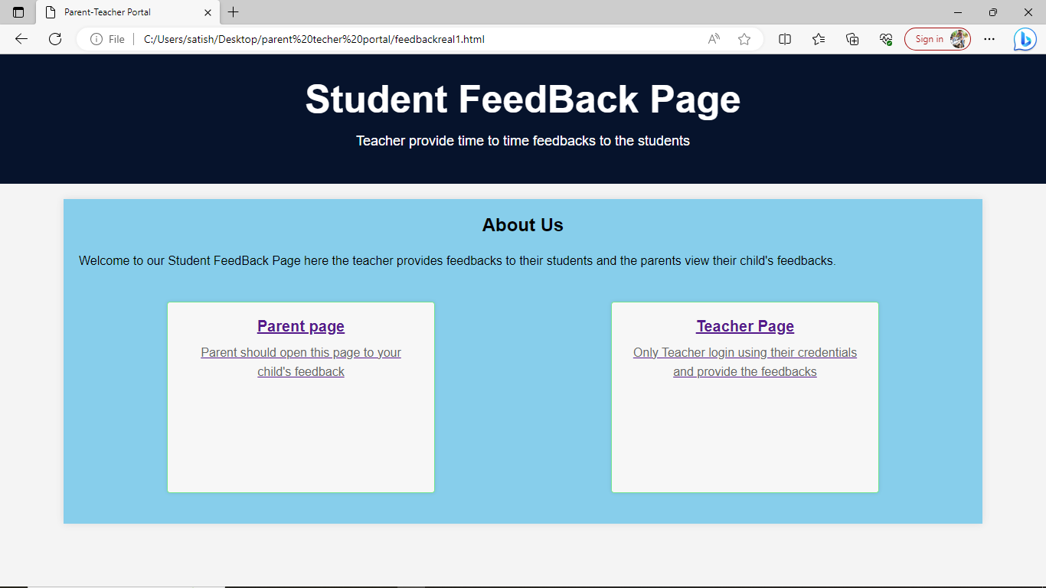
3.Student Feedback:

Slide 16
Backend Databases:
1.Leave table
2.students(feedback database)
3.student_attendance
4.teacher_registration

Slide 17
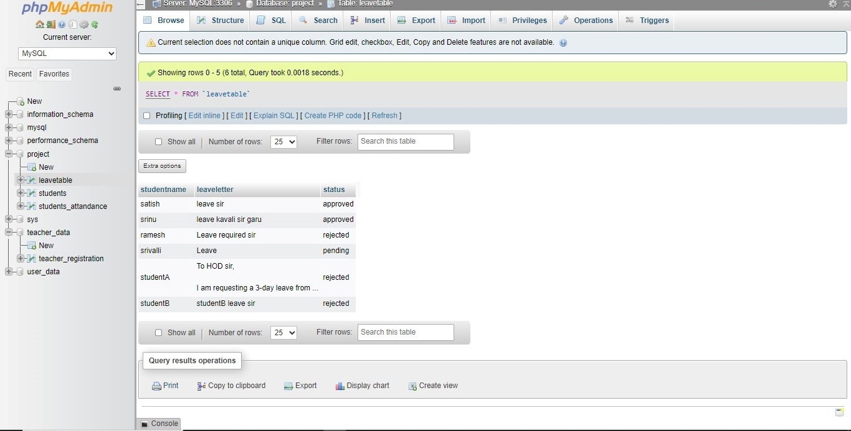
Leave Table:

Slide 18
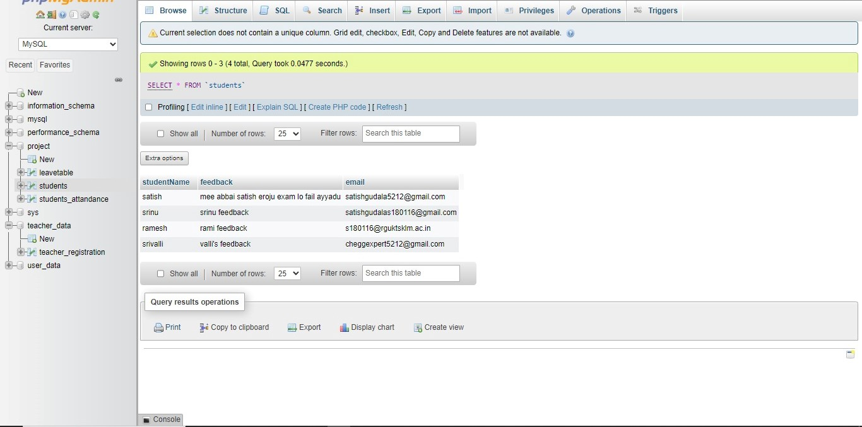
Student Feedback :

Slide 19
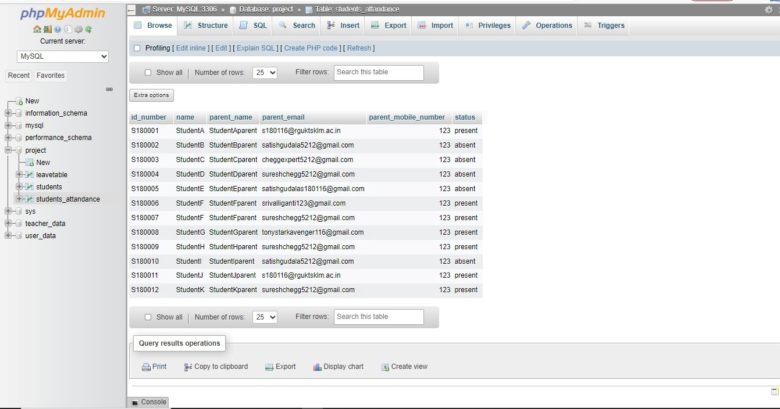
Student Attendance:

Slide 20
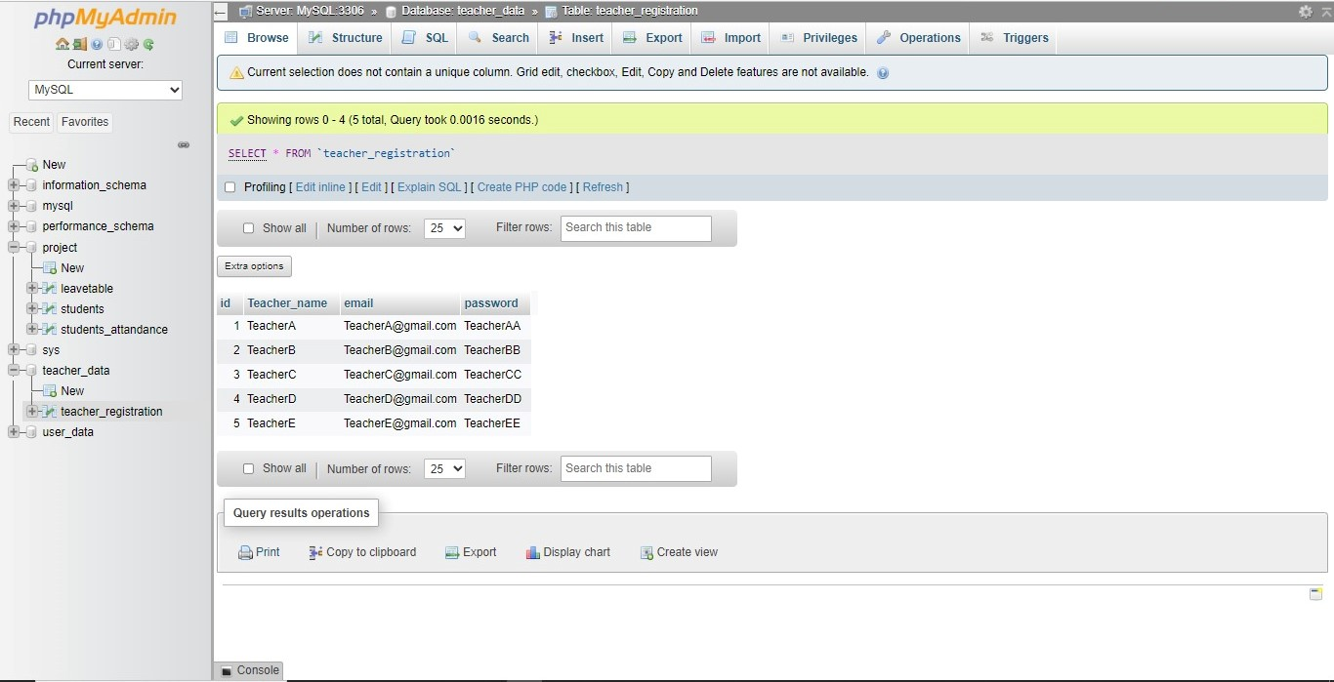
Teacher Registration:

Slide 21
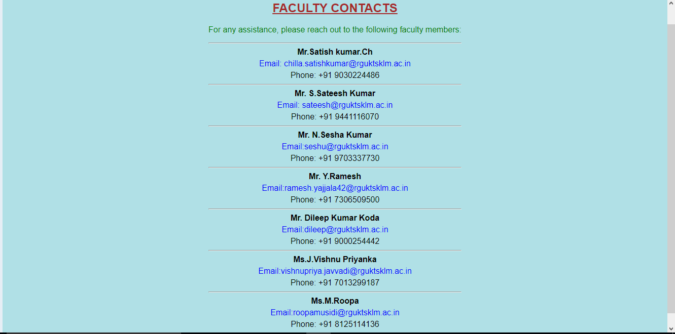
5.Assistance :

Slide 22
THANK YOU

